Slide 1

Forests 2020:
Prediction of Forest Canopy Index Using Support Vector Machine
Presented by
Sahid Hudjimartsu

Slide 2
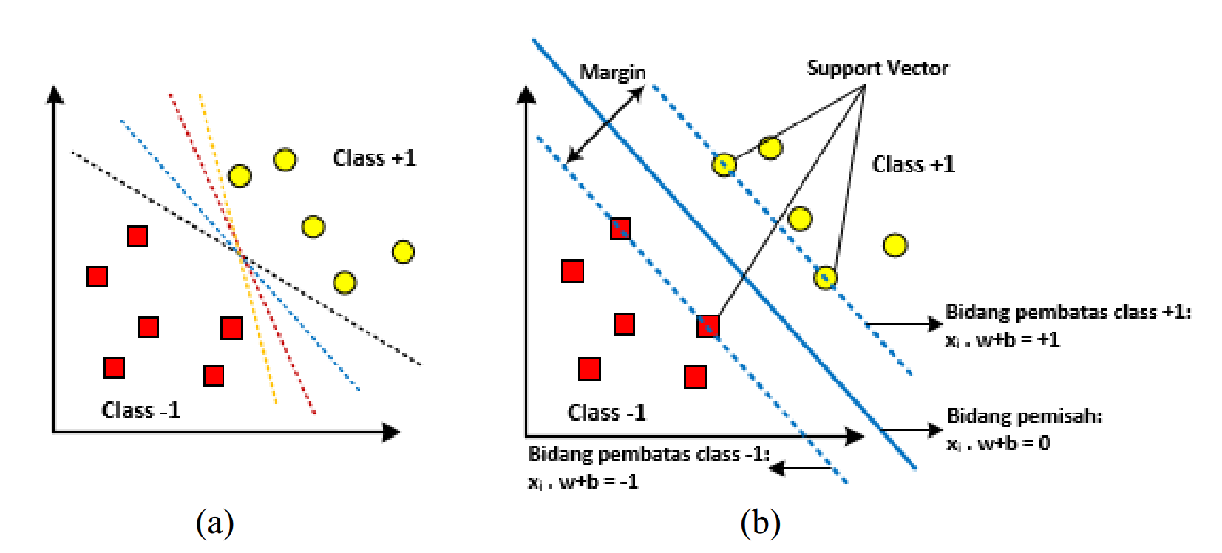
Support Vector Machine:
Classification

Slide 3
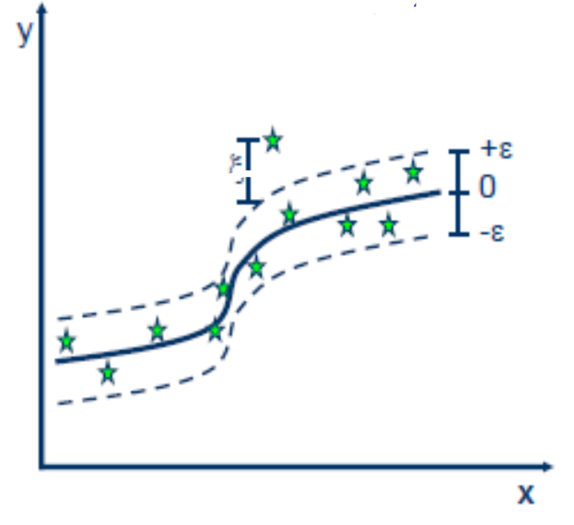
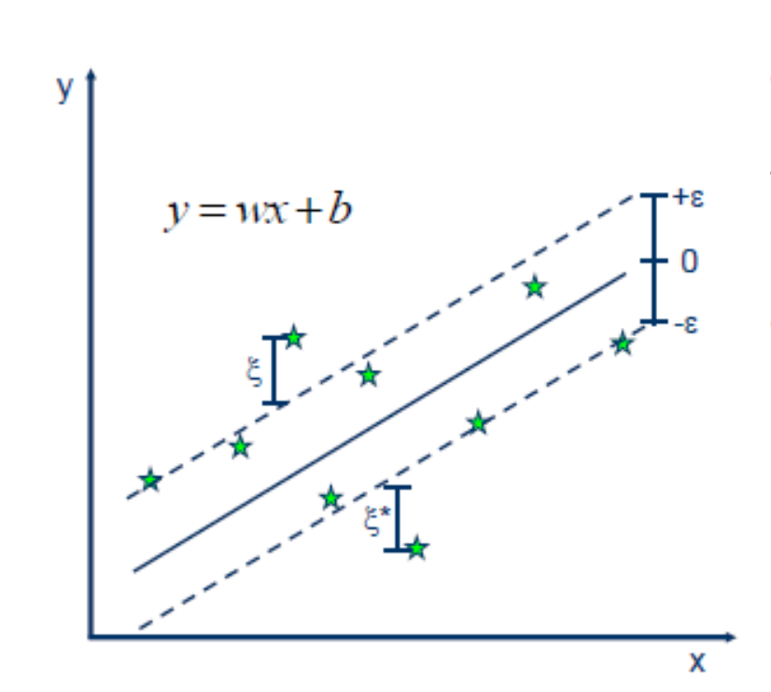
Regression
Linear Vs Non-Linear

Slide 4
FRCI on Agroforestry (Cidanau)
FRCI calculated using LiDAR data
300 Sample data
Divide Data (Training and testing data)
Feature Selection using Boruta Algorithm
K-fold cross validation
Model predicted using SVM

Slide 5
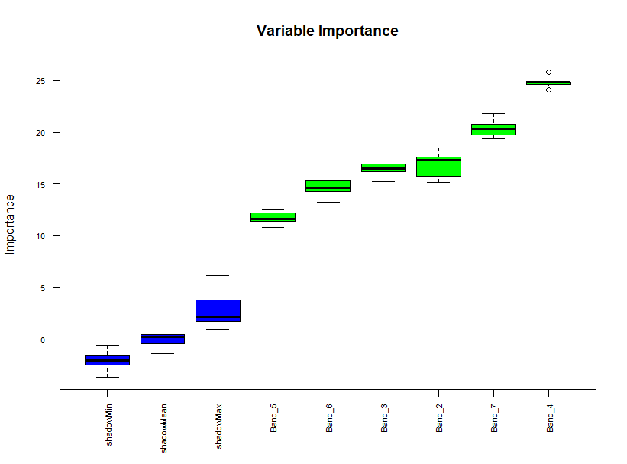
Feature Selection using Boruta Algorithm

Slide 6
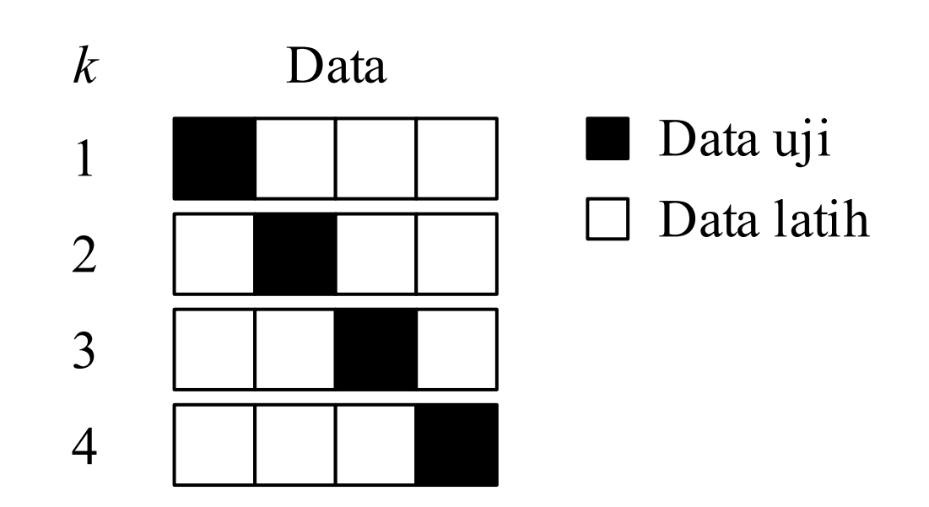
K-Fold Cross Validation

Slide 7
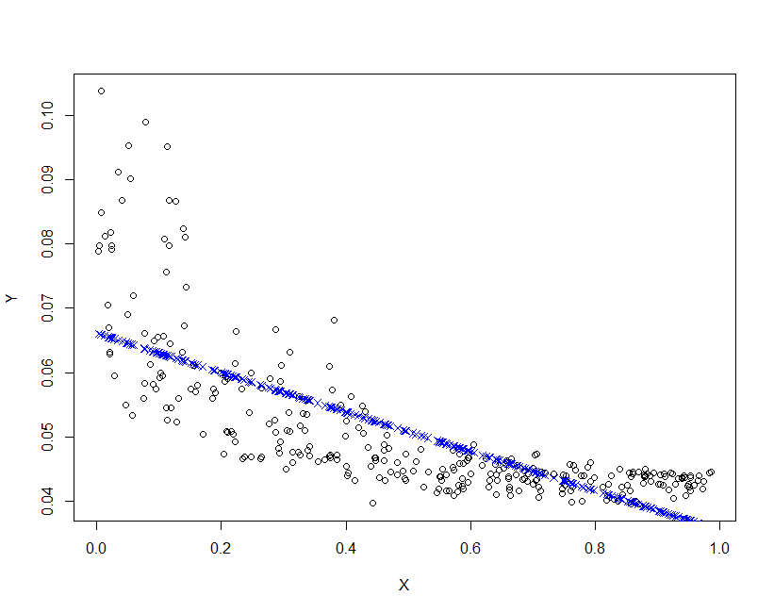
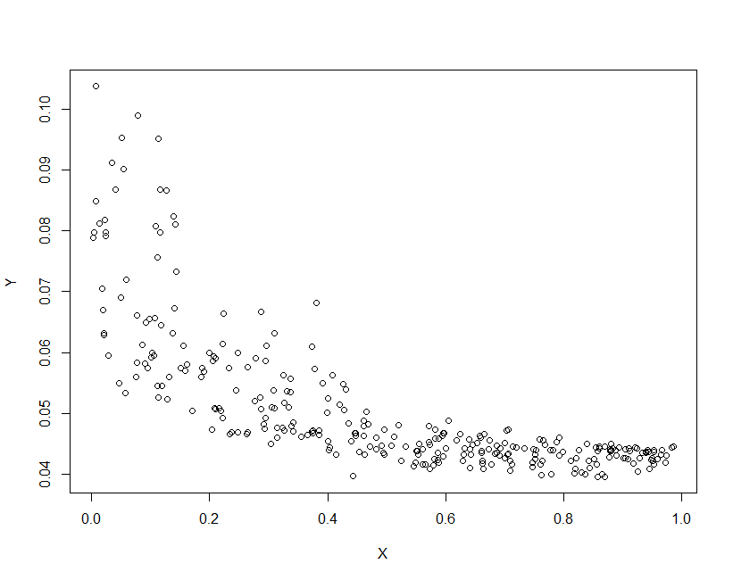
Prediction Model…[1]
Linear Model
RMSE : 0.008028042
FRCI VS Band 4

Slide 8
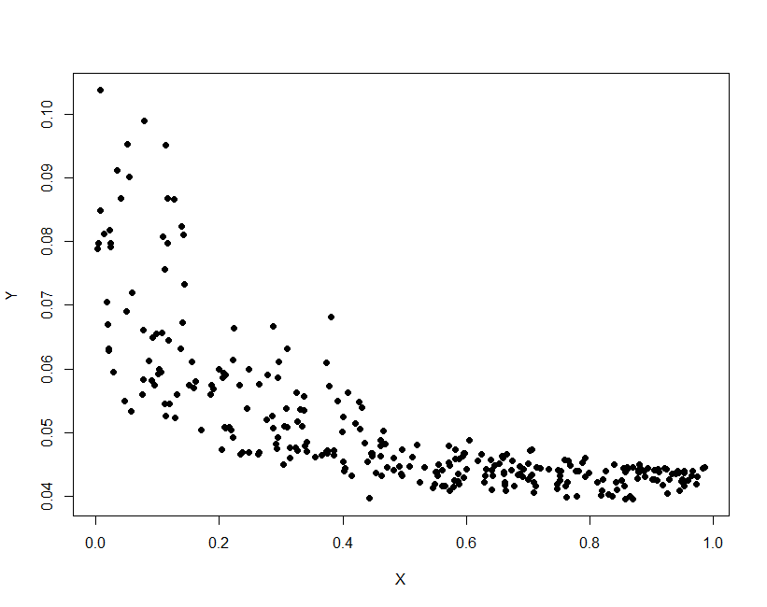
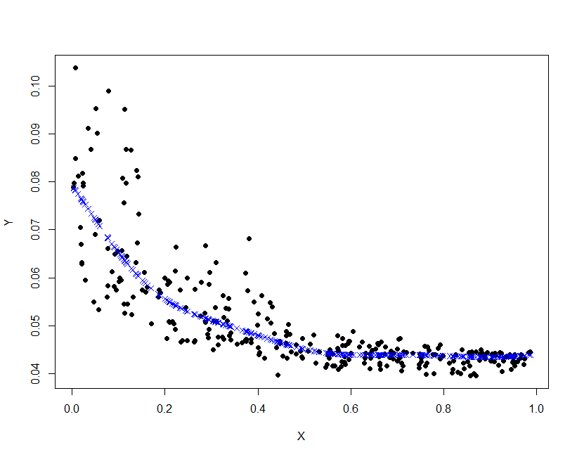
Prediction Model…[2]
SVM
RMSE :0.00645505

Slide 9
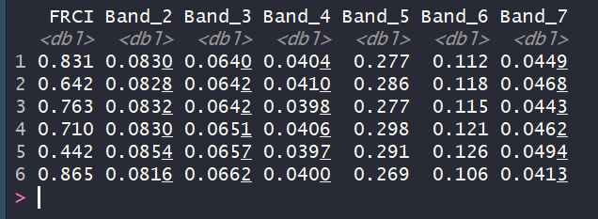
Prediction Model…[3]
SVM
RMSE :0.1188936

Slide 10
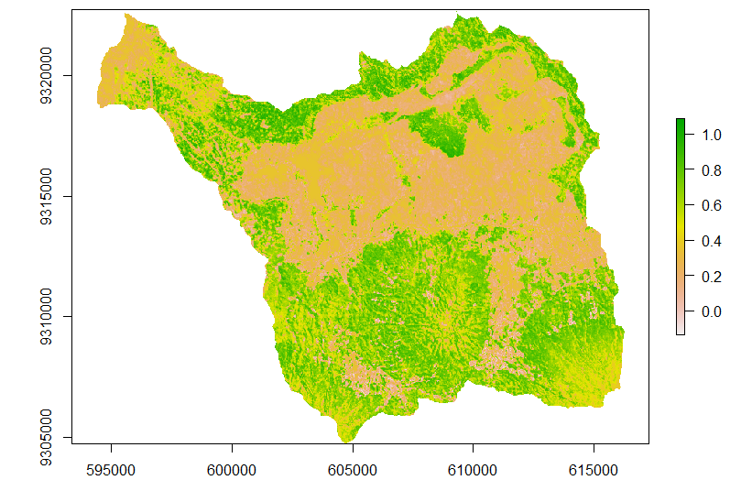
Prediction Map of FRCI

